Slide 1

Abbey CE VA Primary School Reception 2025-26 Welcome to Reception!

Slide 2
The Reception team…
Mrs Pannaman (Monday-Thursday)
Miss Lawford (Friday)
Teaching Assistant
Mrs Lockie (Monday-Friday)

Slide 3
Routines
Hang belongings on peg, change into plimsolls, go to the toilet, place water bottle in the tray, self register, get ready on the carpet
Regular handwashing
Mid morning – rolling snack time. Children are encouraged to be independent
Whole class teaching of new learning in short sessions on the carpet, adult-led tasks, group work, free-flow continuous provision, use of outdoor learning area, 1.1 activities with an adult

Slide 4
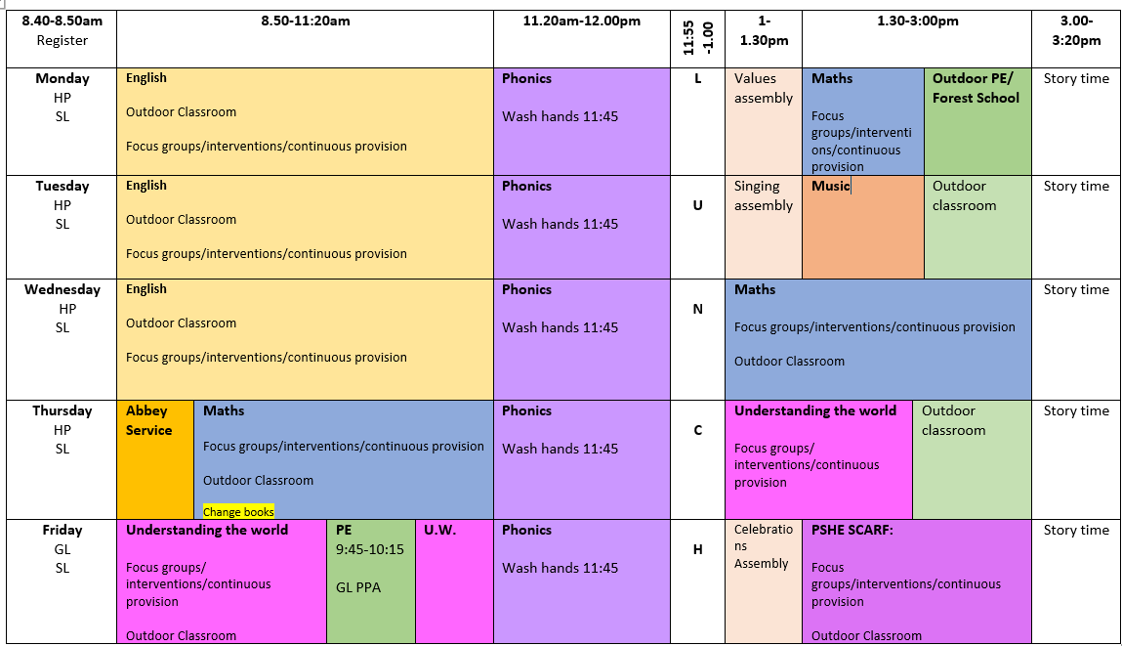

Slide 5
Questions If you have any questions or queries during the week you can:
Email admin FAO Reception Teachers
Book an appointment via the school office to come and see either teacher
Morning messages – send your child in with a brief note to enable us to remain focused on the children coming in
Speak to class teacher at the end of the school day

Slide 6
Dates for your diary
Thursday 9th October - Harvest Festival in The Crossing 9.10am
Parent Consultations (virtual): Tuesday 4th and Thursday 6th November
Wednesday 10th December - Carol Service at the Cathedral 1.15pm (Parents invited)
Wednesday 17th December - Reception Christmas Carol Concert 9.15am (Parents and Special Friends)

Slide 7
EYFS Curriculum Areas
Personal, Social and Emotional Development
Communication and Language
Physical Development
Literacy
Mathematical Development
Understanding the World
Expressive Arts and Design

Slide 8
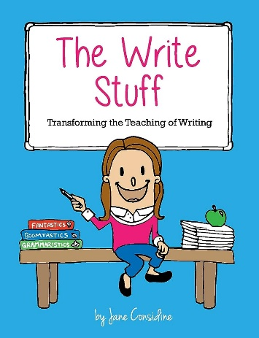
English
The Write Stuff is based on two guiding principles; teaching sequences that slide between experience days and sentence stacking lessons. With modelling at the heart of them, the sentence stacking lessons are broken into bite-sized chunks and taught under the structural framework of The Writing Rainbow. We prepare children for writing by modelling the ideas, grammar or techniques of writing. Key aspects of The Write Stuff system include: 🌟 The Write Stuff builds pupils’ confidence with sentence structure. 🌟 The approach widens the repertoire of writing options for pupils. 🌟 Pupils gain an understanding of the ‘whole’ piece that they are writing. 🌟 Organisation of their ideas and cohesion between them is strengthened.

Slide 9
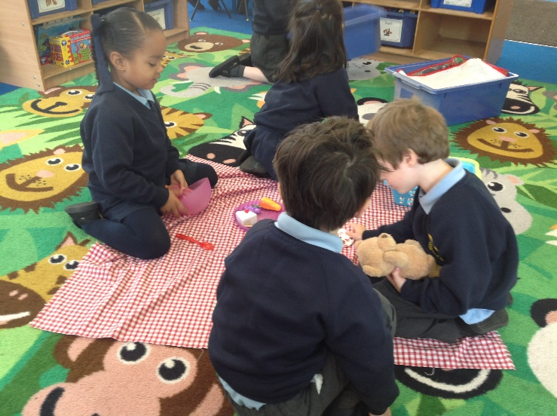
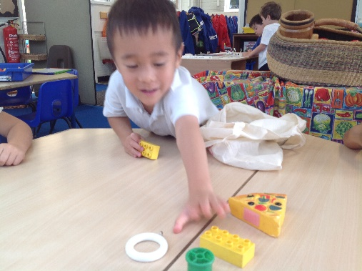
Maths
Match, sort and compare
Measure and patterns
Number: 1, 2 and 3
Shape and measure: Circles and triangles
Number: 1, 2, 3, 4, 5
Shape and measure: Shapes with 4 sides

Slide 10
Reading
The million word gap
Here’s how many words children would have heard by the time they were 5 years old:
Never read to, 4,662 words;
1–2 times per week, 63,570 words;
3–5 times per week, 169,520 words;
Daily, 296,660 words;
Five books a day, 1,483,300 words
“Reading and writing float on a sea of talk.”
Children benefit from reading all around them– road signs, labels, packaging, timetables.

Slide 11

Phonics and Reading
In Reception, children engage in daily Essential Letters and Sounds phonics teaching.
Additional 1:1 reading in the week will take place with either a TA or teacher.
Children will have a phonetically decodable reading book and sharing book to take home. Please fill in the diary to show your child is reading at home. These will be checked once a week. Bring book bags in daily. Books are changed on Thursdays.
An update on the phonics learning we have learnt will be posted on Google Classroom each week – show on GC

Slide 12
Phonics terminology
Blend: To draw individual sounds together to pronounce a word: for example, s-n-a-p, blended together, reads ‘snap’.
Decoding: Extracting meaning from symbols. In the case of reading, the symbols are letters, which are decoded into words.
Digraph: Two letters making one sound: for example, ch, th, sh, ng.
ch-a-t th-i-n
Trigraph: Three letters making one sound: for example, igh, ear.
Split digraph: A digraph ‘split’ by a consonant: for example a-e in the word ‘cake’ or o-e in the word ‘stone’.
Grapheme: A letter or a group of letters representing one phoneme: for example, <sh>, <ch>, <igh>, <ough> (‘though’).
Phoneme: The smallest single identifiable sound: for example, the letters ‘sh’ represent just one phoneme (/sh/) but ‘sp’ represents two (/s/ and /p/).
Segment: To split up a word into its individual phonemes in order to spell it: for example, the word ‘cat’ has three phonemes /c/ /a/ /t/. Children are asked to count the individual sounds in the word to help them to spell it.
Sound talk: Oral sounding out of a word: for example, c–a–t.
Stretch: Elongate the sounds in a word to allow you to hear each sound clearly: for example, ‘caaarrr’.

Slide 13
How to support your child
Identify rhyming words in story books
Play I Spy with initial sounds/sound talking
Make it fun – phonics/maths games
Opportunities to be creative at home – drawing, painting etc
Activities to develop fine motor strength – play dough, lego
Home reading - your child should read the words to you, pointing with their finger. When reading a word, your child will read each individual sound aloud then blend them together to read the word, e.g. r-e-d…red
Once they have sounded out each word they reread the sentence without sounding out. This skill takes time to develop so they may need your help with this initially
If your child is not yet able to sound out or blend, model saying the sounds and blending for them to repeat after you.
‘Harder to read and spell’ words cannot be sounded out, e.g. ‘the’

Slide 14
What your child needs in Reception…
Please name everything! Bags, water bottles, shoes, uniform
Spare clothes in a named bag on peg
Water bottle – washed and refilled at home. Please do not carry within book bag
Book bag – always keep reading books inside
PE kit and trainers on Mondays and Fridays
Well-fitted plimsolls. Please check each half term

Slide 15
Questions Thank you for coming!
Google Classroom – logins and notifications
Volunteers – trips, reading in class 1:1

